Slide 1
Search Engine Optimization
Chapter 1 : The Search Engine

Slide 2
Introduction :
What is Browser
What is Search Engine
Difference
Different Search Engines

Slide 3
Browser :
A software application
Provides Facilities for search, accessing information
Other facilities like downloading, history, bookmarks, cookies
User request for a web page, browser retrieves content from server

Slide 4
Search Engine :
Is a program or a tool
Searches for results in database
Search based on keywords
Sorts the results and give in ordered list
Uses different algorithms

Slide 5
Different Search engines :
Google
Yahoo!
Bing
Baidu
Duck Duck Go
Yandesk
Ask
Lycos

Slide 6
Mission of Search Engine :
Free to use
Gives most relevant results
Invests time, efforts for most relevant content
Generates revenue through paid advertising
Pay-per-click or Cost-per-click model
Non relevant content as spam

Slide 7
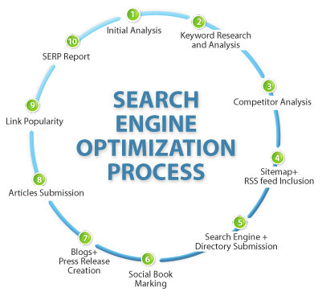
SEO Process :

Slide 8
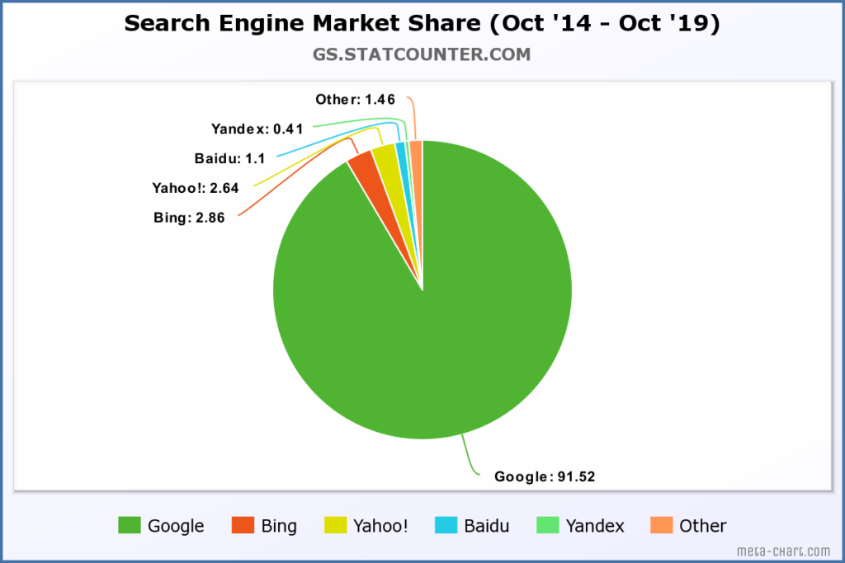
Market Share of Search Engine :

Slide 9
Cont…
Google search engine covers most of the part
In China, Baidu is the leading search engine
Heavy focus on Google in most of the countries

Slide 10
Human Goals Of Searching :
Basic goal is to gather relevant information
Need for answer or solution or piece of information
Execute the query, check results, and check if you got what you wanted and if not, then try a refined query.

Slide 11
Determining Searcher Intent :
SEO practitioners and the SE have common goal of providing searcher with results that are relevant to queries.
Once you get how people search for service, product or resource, you can reach more effectively
Different types of Queries :
Navigational Query
Informational Query
Transactional Query

Slide 12
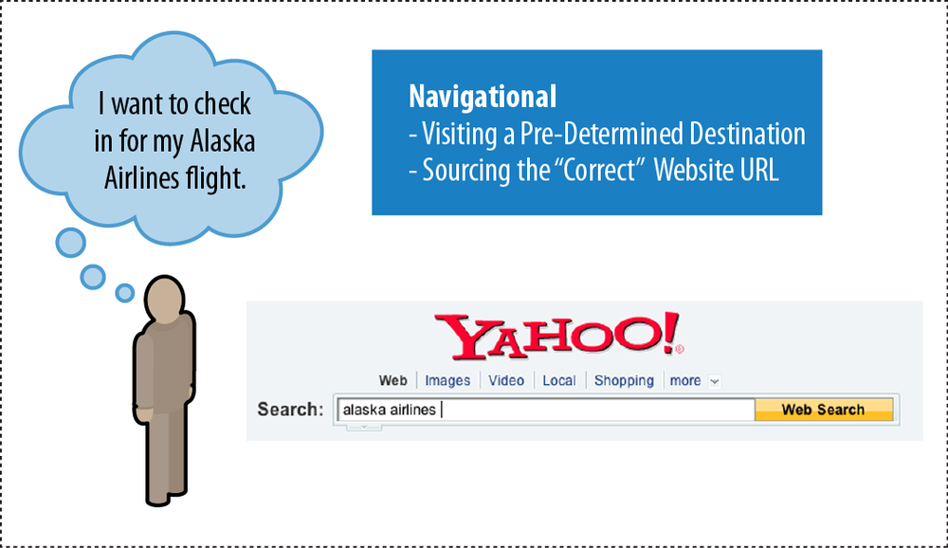
Navigational Query :
Performed with the intent of surfing directly to a specific website
User may not know exact URL

Slide 13
Opportunities and Traffic value :
Pull searchers away from destination
Get investigatory traffic

Slide 14
Informational Query :
Includes huge range of queries
Example, local weather, maps, directions, award ceremony, stock market values, to 10 students list of any university, etc..
Primarily non-transaction-oriented (only includes information about a product or service)
No interaction, only clicking and reading information is required.

Slide 15
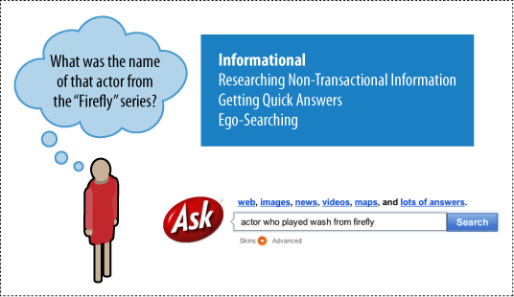

Slide 16
Opportunities and Traffic :
Brand searchers with positive impression of your site, company
Attract Inbound Links
May convert to sign up or purchase

Slide 17
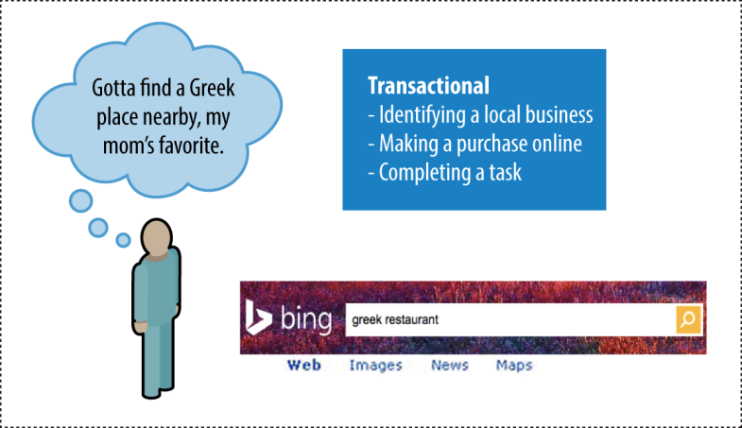
Transactional Query :
Don’t compulsory need credit card or other transfer
Example, Sign up for free trial accounts, creating mail account, paying for tickets, finding best local restaurant and booking

Slide 18
Opportunities and Traffic :
Achieve transaction (Finance or other)
Traffic may be very high.

Slide 19
How people search :
Important element
SE invests significant resources understanding how people use search, enabling them to produce better, faster, fresher, more relevant
For website publishers, information about how people search can be used to help improve the usability of a site as well as compatibility with SE.

Slide 20
Cont…
Category Name | Total searches
Entertainment | 2,789,625,911
Retail | 1,686,123,715
Services | 1,288,400,837
Travel | 462,129,798
Health | 435,860,663
News/ Information | 421,756,642
Sports | 297,503,391

Slide 21
How SE drive commerce on the web :
People use SE for wide variety of purpose, like research, locate and buy products
Two types of markets :
Online
Offline
Online : Offline > 1 : 6
According to Forrester research, over $155 billion worth consumer goods were purchased online in US in 2009
Local search is increasingly important component of SEO

Slide 22
Eye tracking : How user scan result pages
Research firms Enquiro , Eyetool , Didit conducted Heat-map testing with search engine users.
The graphic will indicate that users spend most amount of time focusing their eyes in the top-left area, where shading is darkest.
SERP (Search Engine Result Pages) is attracting images on results.
Viewing standard Google results page, users tended to create an “F-shaped” pattern with their eye movements, focusing first and longest on the upper-left corner of the screen.
Moving down vertically through the first two or three results, moving across first paid result.

Slide 23
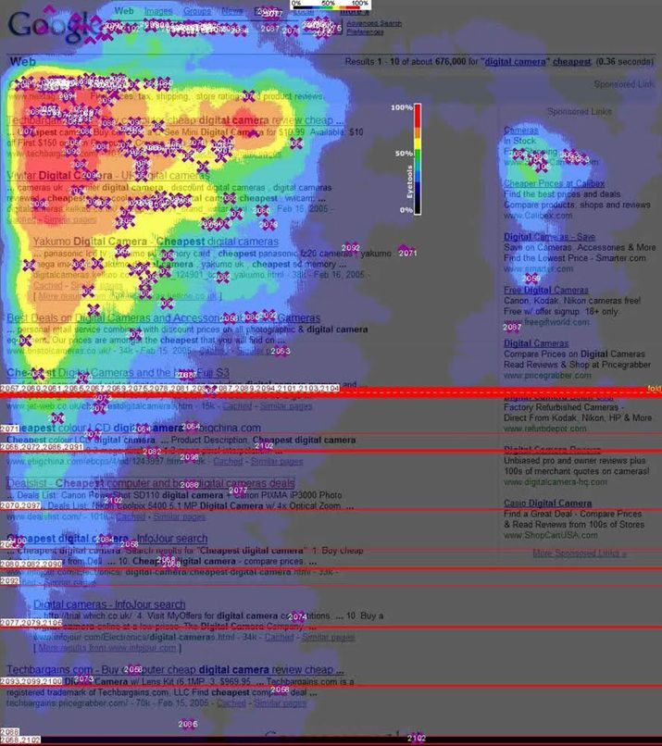

Slide 24
Cont…..
In May 2008, Google introduced the nation of Universal Search
This was just showing 10 most relevant web pages (now 10 blue links)
Now results are shown via media, videos, images, news and so on.
Other search engines followed within few months, and further this general concept referred as Blended Search
Generally users focuses on image or video thumbnail first

Slide 25
Click tracking : How users click on results
Natural V/s Paid
Click tracking is second process after eye tracking
85% of searchers click on natural results

Slide 26
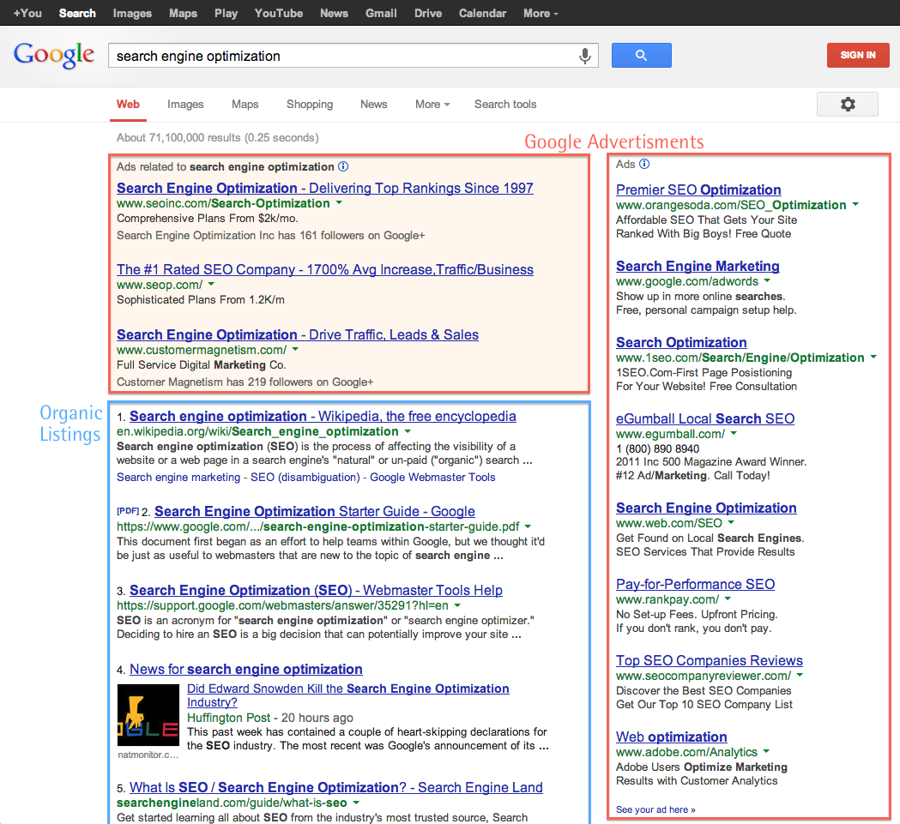

Slide 27
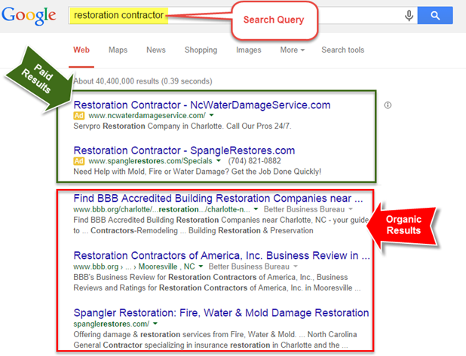

Slide 28
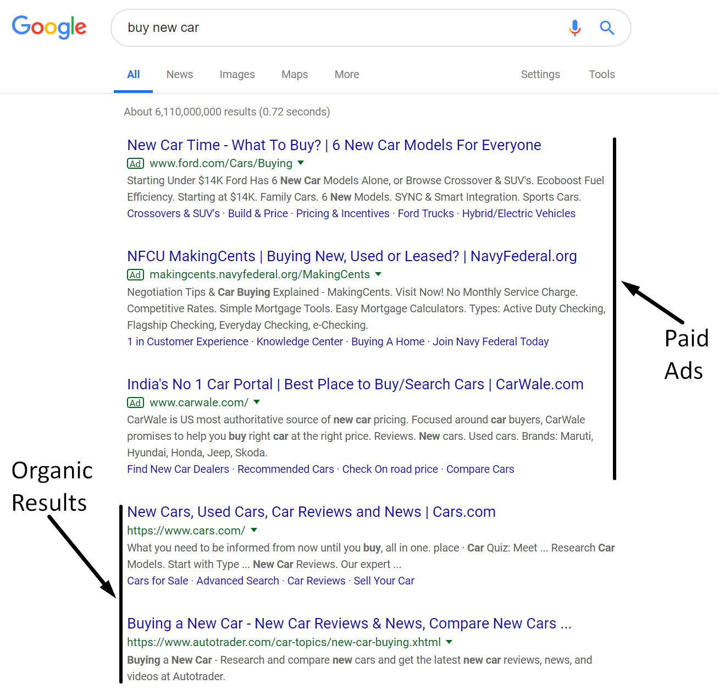

Slide 29
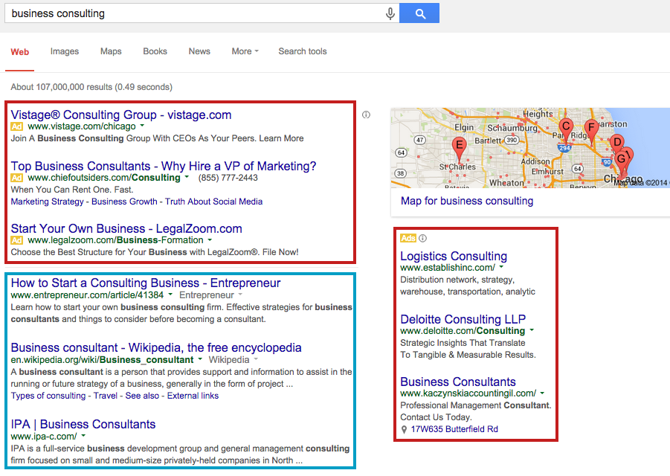

Slide 30
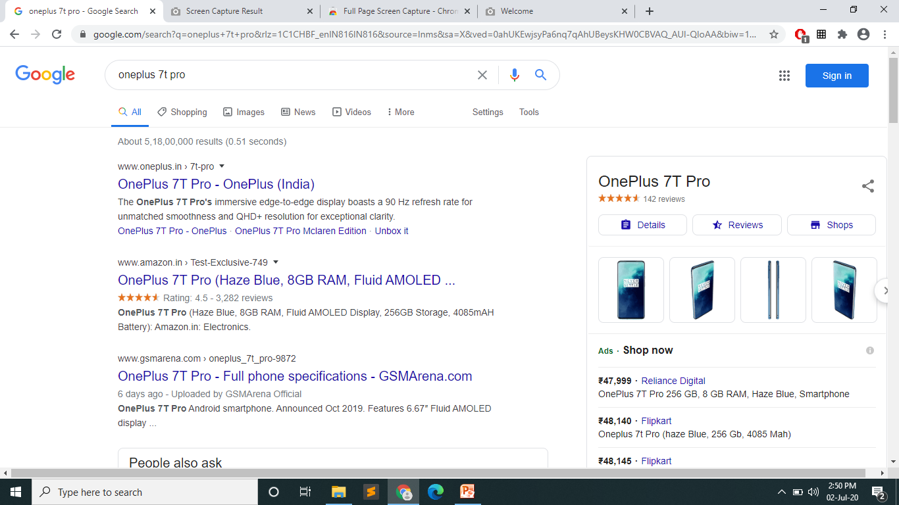
Paid results
Timings for result
Natural results

Slide 31
Natural V/s. Paid Results :
Natural Results | Paid Results
It costs nothing | Costs
Attracts relevant users | Attracts ready-to-buy users
Unpaid section of SERP | Paid section of SERP
Content is relevant to search query | Content is relevant to marketing
Organic rank does not cost anything | Site owners have to pay for their rank on top
Appears in the middle of the page | Appears in the top of the page
Longer process to get rank on top | By paying big amount, you’ll get top rank
It is long lasting | When you stop paying, you will loss top position

Slide 32
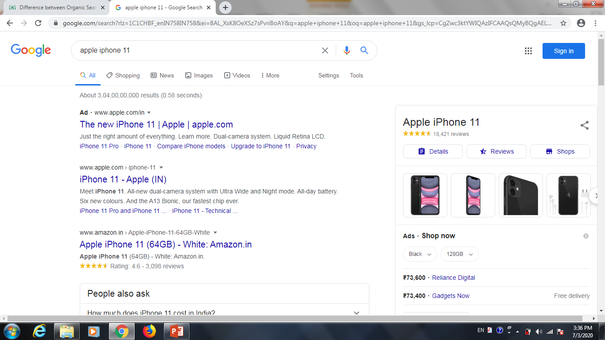
Understanding Search Engine Results (Google):
Paid Results
Filters
Timing
Organic Result

Slide 33
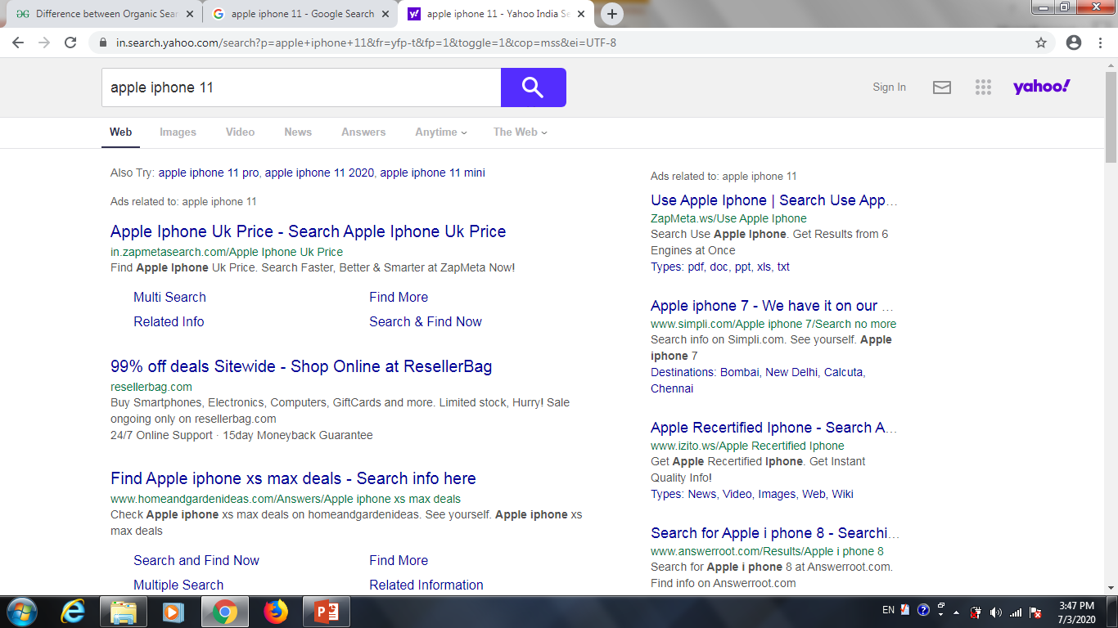
Yahoo! Results :
Filters
Paid
Paid
Organic

Slide 34
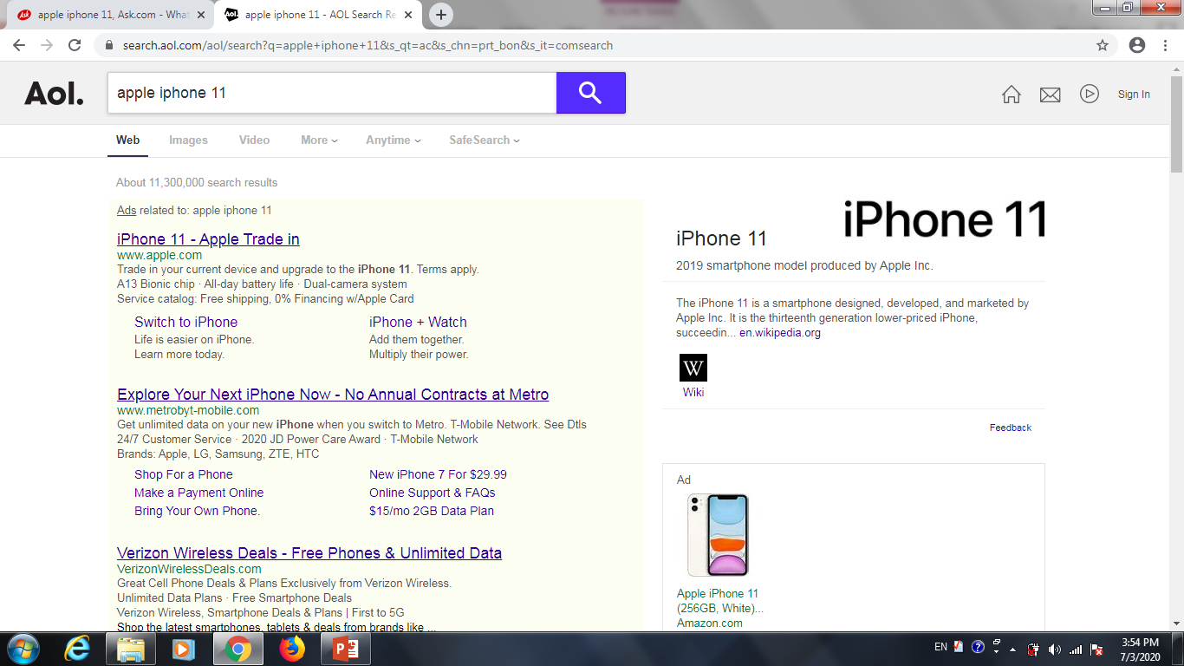
AOL Results :
Filters
Timing
Paid
Organic

Slide 35
Points to understand :
Vertical Navigation :
- All Search engine has different navigation
- Each offers video, image, news, map
Search Query Box :
- All SE allows search query box, edit query, re-enter query in search box
- Some provides advance filter search box

Slide 36
Result Information :
- Displays in two parts:
1) Paid results
2) Natural (organic) results
- Each SE displays small information about website and navigation link
- Each SE has number of result pages
PPC Advertisement :
- Google provides google AdWords, Sponsor links
- Yahoo! Provides Sponsor links, search marketing
- Bing provides adCenter
- fix bid amount( ad requires maximum bid, compared with other ad bids.

Slide 37
Natural/organic/ Algorithmic Results
- Primary section of SE, depends on SEO
- If we create SEO regularly, web site rank goes up
- This is regular process
Query Refinement
- Now offered by all three popular SE
- Google, Yahoo!, Bing
- Goal is to get appropriate links

Slide 38
Algorithm based ranking system :
Crawling, Indexing and Ranking
Search algorithm is a PSP (Problem Solving Procedure)
It takes problem
It generates number of possible answers
Returns solution of problems (query)
Search algorithm results those results based on the best quality of the page
Result may change in different SE because different SE uses different algorithms

Slide 39
Crawling :
What is Crawling ?
It is a discovery process. Crawling is the process by virtue of which the search engines gather information about websites on WWW (new/old updates etc)
Content may be images, videos, content or other.
The crawlers are also known as spiders or bots, they visit websites and send information to their respective parent websites.

Slide 40
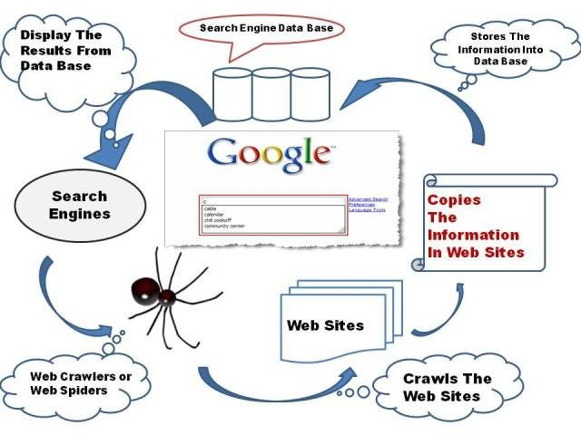

Slide 41
Indexing :
What is Indexing ?
Indexing is the process of adding webpages into Google or other search engine depending upon which Meta tag you used (index or No-index)
Google will crawl and index your pages. A no-index tag means that the pages will not be added into the web search index.

Slide 42
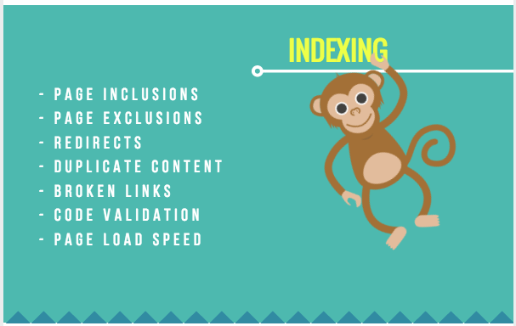

Slide 43
Ranking :
Ranking refers to a website’s position in the search engine result pages.
There are various ranking factors that influences if a website appears higher on the SERP based on the content relevance to the search term, or the quality of backlinks pointing to the page.

Slide 44
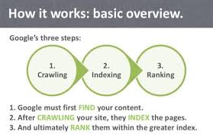

Slide 45
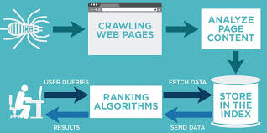

Slide 46
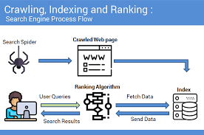

Slide 47
Categories (types) of algorithms :
Three types :
On-page algorithm
Whole-site algorithm
Off-site (off-page) algorithm

Slide 48
On-Page Algorithm :
Based on user thinking
Includes how keywords are used in web page concept
Also, how other words relate on the page
Suppose a page is created on “Kamani science college”
How many times “kamani” keyword is used
How many titles as “kamani”
Similar words

Slide 49
Cont…
Algorithms never give result on web page, this works on back side (developer side)
Web page contains keywords for web crawlers, this content is called META TAGS
When crawler (spider) examines your web site, it looks these tags as definitions for what you search in web site.

Slide 50
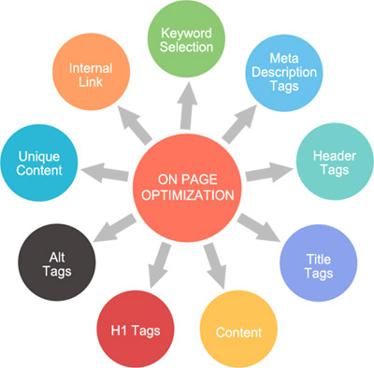

Slide 51
Whole-Site Algorithm :
This algorithm look at the relationship of pages on a site
i.e. all web site pages are having related content or not
All web pages must have same viewpoints
This also contains :
Site elements
Architecture of pages
Use of anchor text <a>Click Here</a>
Pages linked with each-other
Covers multiple topics or subjects

Slide 52
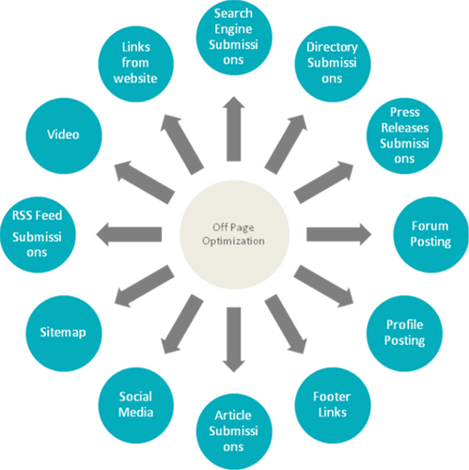
Off-Site Algorithm :

Slide 53
Cont….
Checks how my web pages rank in SERPs
Used for good incoming links, high page rank, etc…
In short, this algorithm adds how t.he quality of your pages is ranked

Slide 54
Additional Algorithms :
List Search (Single key, result is single element, very time consuming)
Tree Search (narrow-to-broad or broad-to-narrow)
SQL Search (not hierarchical like tree, can start from any point)
Informed Search ( like tree, specific question answer type)
Adversarial Search (display all possible solution, difficult to use)
Constant Satisfaction Search (Use different constraints)

Slide 55
Analyzing Ranking Factors :
moz.com periodically conducts surveys of leading search engine optimizers to determine what they think are the most important ranking factors.
They are divided into mainly 3 :
Positive Ranking Factors
Negative Ranking Factors
Other Ranking Factors

Slide 56
Positive Ranking Factors :
Keywords used in <title>
Age of site
Site’s internal linking structure
Topic relevance of inbound links
Keywords used in <body>
Global link popularity of site that link to the site

Slide 57
Negative Ranking Factors :
Server is often inaccessible to crawler
Content very similar to or duplicate of other web pages
Low quality links / spam sites
Duplicate titles / meta tags on many pages

Slide 58
Other Factors :
Usage data
User data
Google sandbox – work as a filter

Slide 59
Using advanced search techniques :
[-keyword] : Searches for loans –hdfc will give result for all types of loans except hdfc loans
[+keyword] : Allows us to combine one or more terms in our searching
[“key phrase”] : Allows us to search whole phrase like “seo companies”
[keyword OR keyword] : Shows result of at least one keyword

Slide 60
Advanced Google Search Operators :
Operator | Description | Example
Site: | Domain restricted search | Site:www.moz.com
Inurl: | The term must appear in the url of the page | Inurl:pizza
allinurl: | The whole term must be in the url of the page | allinurl: seo, moz
intitle: | The searched term must appear in title tag | Movies intitle: hindi
allintitle: | The whole term must appear in the title of the page | allintitle: google tools
inanchor: | The term must appear in anchor text of the links to the page | Hotels in amreli inanchor: veg
allinanchor: | The whole term must appear in anchor text of links text of page | allinanchor: seo sites

Slide 61
Cont…
intext: | The term must appear in the text of the page | Cricket intext:dhoni
allintext: | All query words must appear in the text of the page | allintext: free sms sending
ext: / filetype: | Search for particular file type | J2ee filetype:pdf
* (wildcard) | Replace any term with * | Thomas * Edison will result in, Thomas Edison Thomas A Edison Thomas Alva Edison Thomas John Edison
related: | List web pages that are similar to or related to the URL | related: www.way2sms.com
info: / id: | Find info about a page | info:www.kscpac.org
cache: | Display Google’s cached version of a web page | cache: www.moz.com

Slide 62
Cont…
~ | Synonyms | Gives synonym of given word
… | Range search | 14 inch … 16 inch laptops
define: | Searches for definitions of words from various web sources | define: cluster define: cloud computing
movie: | Searches for show times by location | movie: thor
phonebook: | Displays phonebook listing Bphonebook: business listing Rphonebook: residential listing Phonebook: both | phonebook: narendra modi
stocks: | Gives current stock market value | stocks: LMT
book: | Gives full description of book | book: 3 mistakes of my life

Slide 63
Cont…
weather: | Gives present weather information | weather: amreli
location: | Gives location about particular thing for particular city | Burj khalifa location: dubai

Slide 64
Vertical Search Engines :
Vertical search is the term people use for specialty search engine that focus on a limited data set
Example of vertical search engine that are mostly provided by major search engines are image, video, news and blog search
Vertical search engines from the major search engines are :
Google :
Google maps, Google images, Google product search, Google blog search, Google video, Google news, Google custom search engine, Google book search, Google US gov search etc

Slide 65
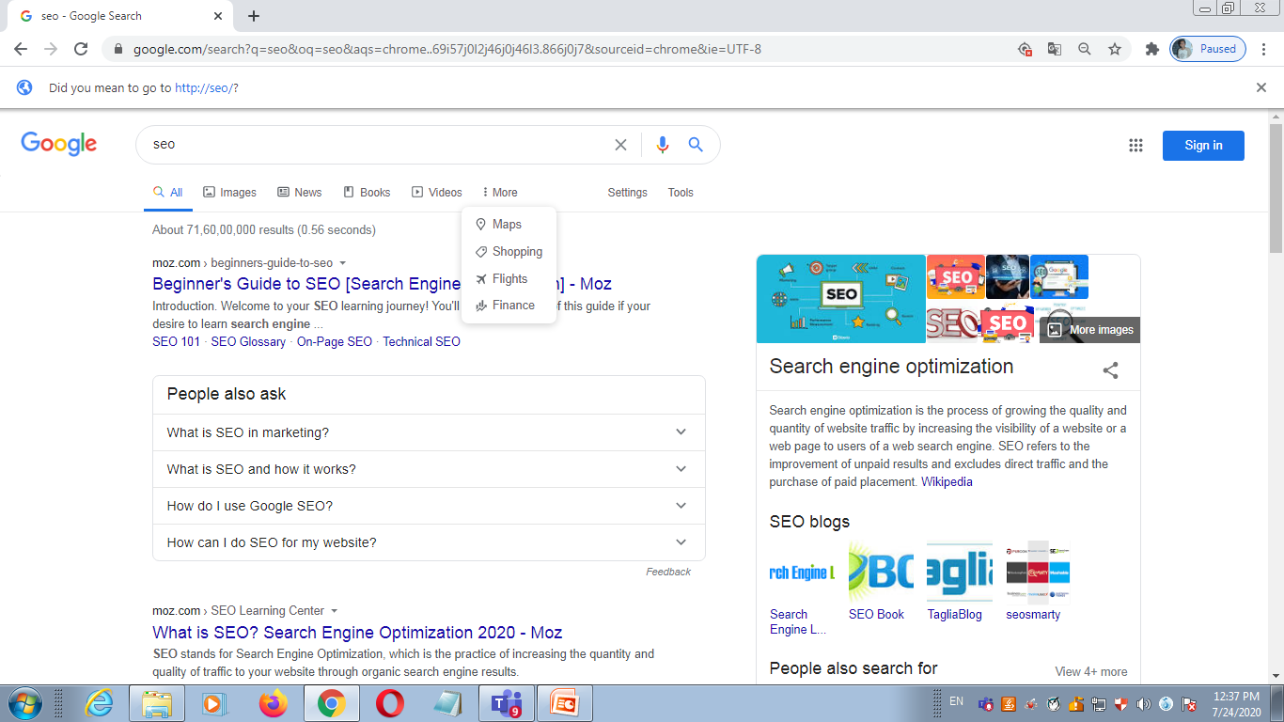
Google :

Slide 66
Cont….
2. Yahoo!
Yahoo! News, Yahoo! Local, Yahoo! Images, Yahoo! Video, Yahoo! Shopping, Yahoo! Audio search, etc…
3. Bing
Bing image, Bing video, Bing news, Bing maps, Bing health, Bing products etc

Slide 67
1. Image Search :
All three of the big search engine offer image search capability
Basically image search engine limits the data that they crawl, search, and return in results to images
This means files that are in GIF, TIF, JPG, and other similar formats
Thus, an image is a binary file, it cannot be readily interpreted by a search engine crawler.

Slide 68
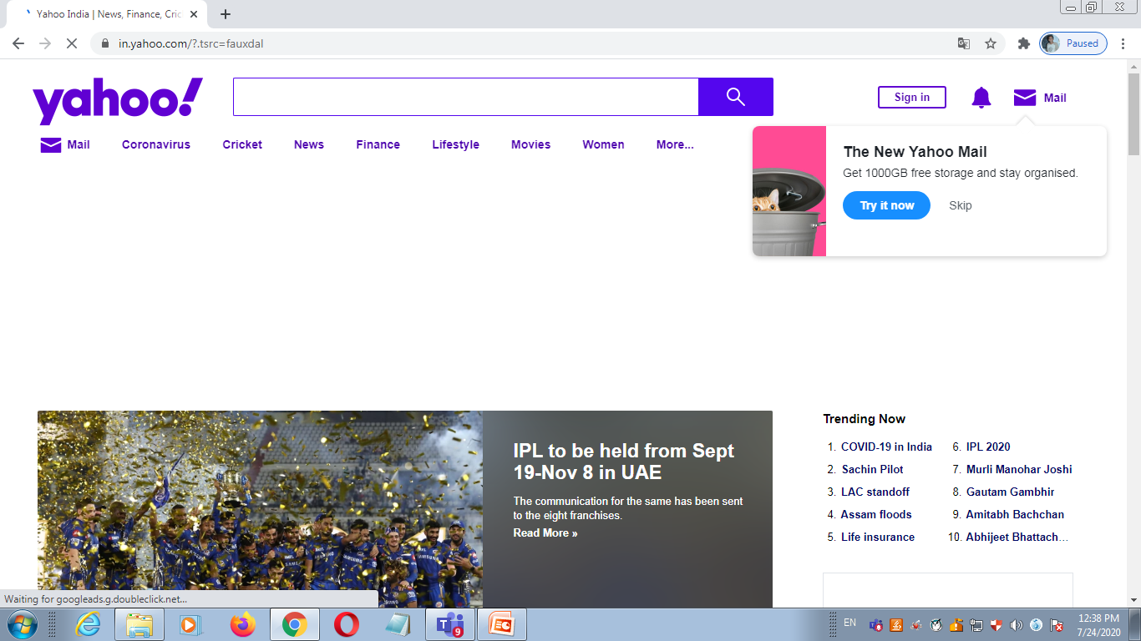
Yahoo! :

Slide 69
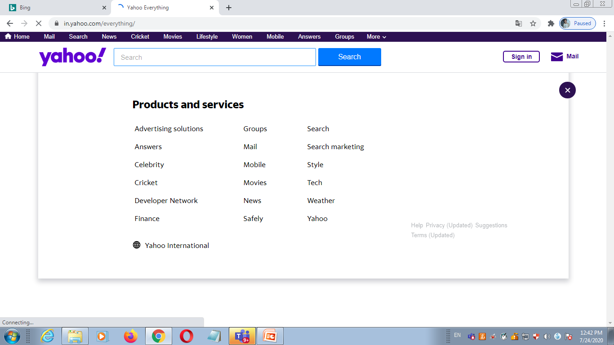
Yahoo! :

Slide 70
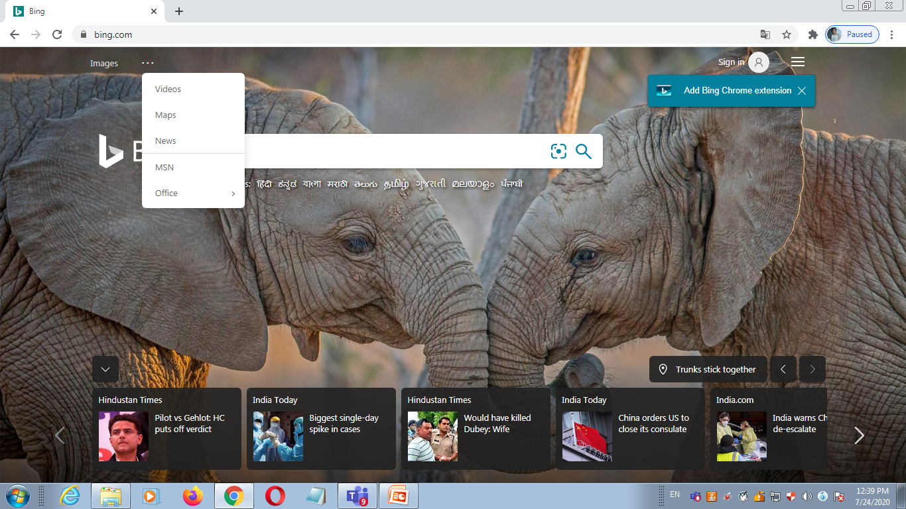
Bing :

Slide 71
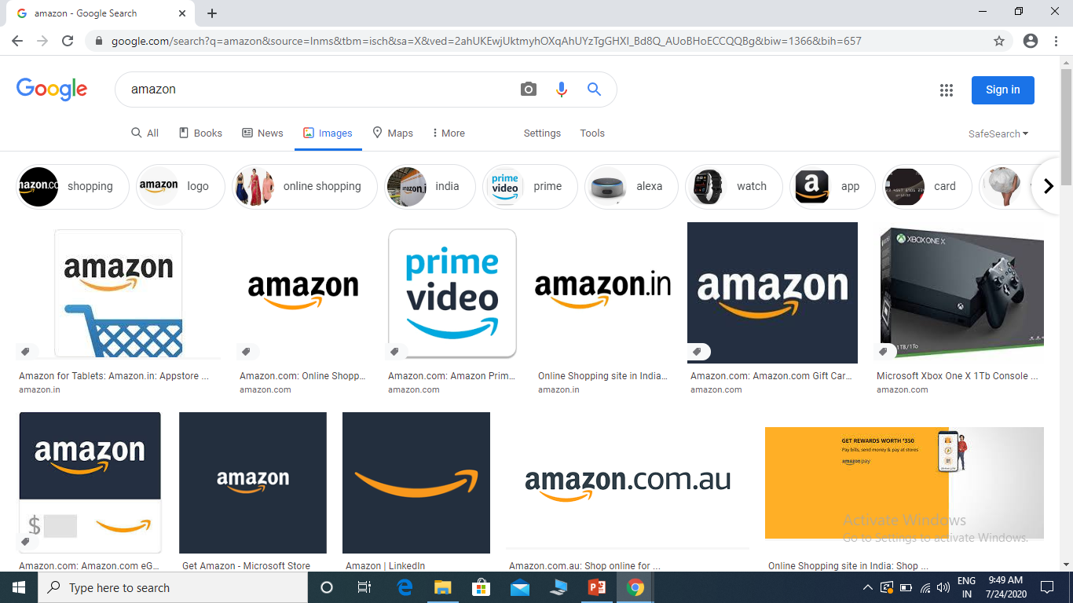
Cont…

Slide 72
2. Video Search :
As with image search, video search engine focus on searching specific types of files on the web – in this case, video files in formats such as MPEG, AVI, and others
A very large number of searches are also performed in video search engines
Once again, these are binary files and the search engine cannot easily tell what is inside them
Each SE is investing in technology to analyze images and videos to extract as much information as possible
For ex, OCR technology is being used to look text within images and video content

Slide 73
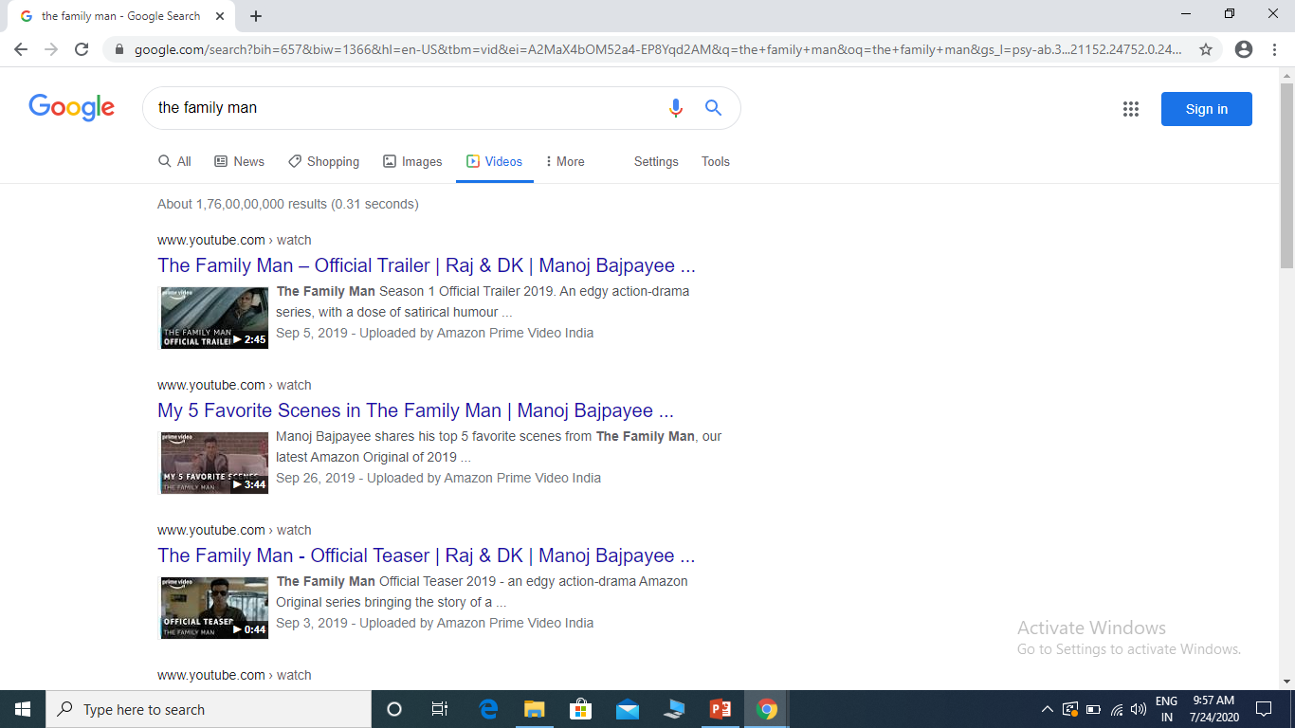
Cont…

Slide 74
3. News Search :
News search is unique,
News search results operate on a different time schedule, as they must very timely
News search engine must be able to retrieve information in real time and provide nearly instantaneous responses
Modern consumers tend to want their news information now
As with the other major verticals, there is a lot of search volume here as well
So the topical news stories have to be generated on regular basis

Slide 75
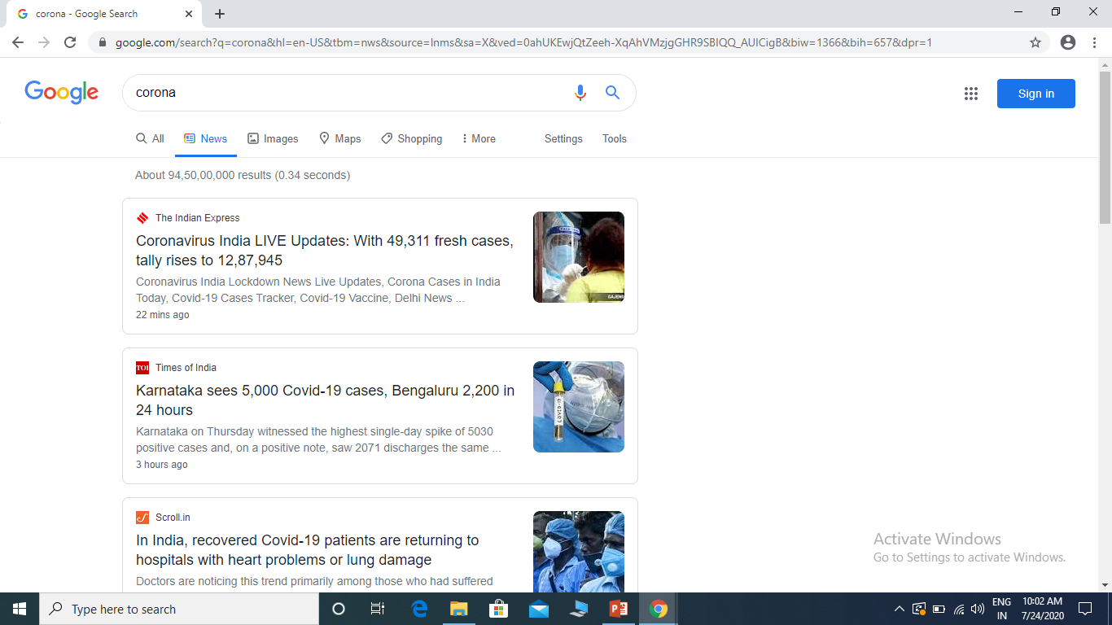
Cont..

Slide 76
4. Local Search / Maps :
Next up in our hit parade of major search verticals is local search aka map search
Local search results are now heavily integrated into the traditional web search results, so a presence in local search can have a large impact on organizations that have one or more locations
Local search engines search through database of locally oriented information like names, phone numbers, and locations of local business around the world or just provide service such as offering directions from one to another location

Slide 77
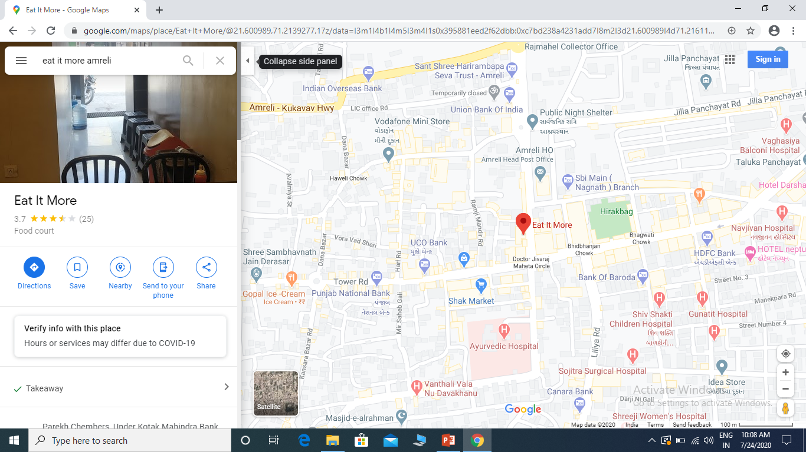
Cont…

Slide 78
5. Blog Search :
Google has implemented a search engine focus on blog search called Google Blog Search (misnamed because it is an RSS feed engine and not a blog engine)
This search engine will respond to queries, but only search blogs to determine results

Slide 79
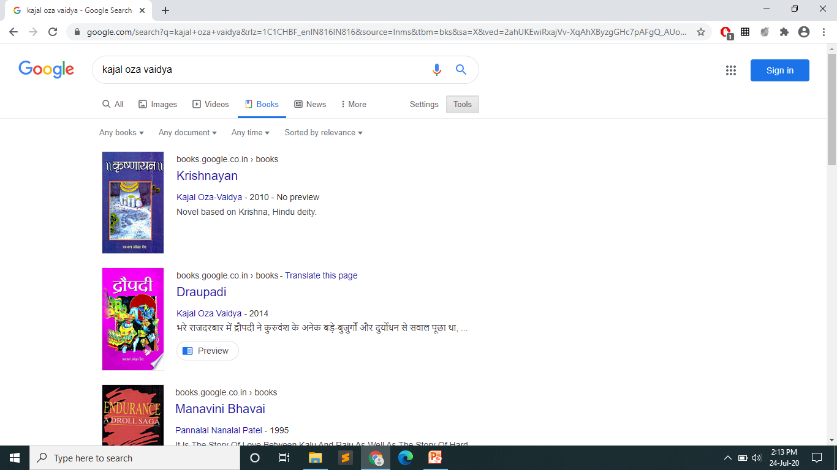
6. Book Search :
The major search engine also offers book search
One highly vertical search engine is book search which specially searches only content found within books

Slide 80
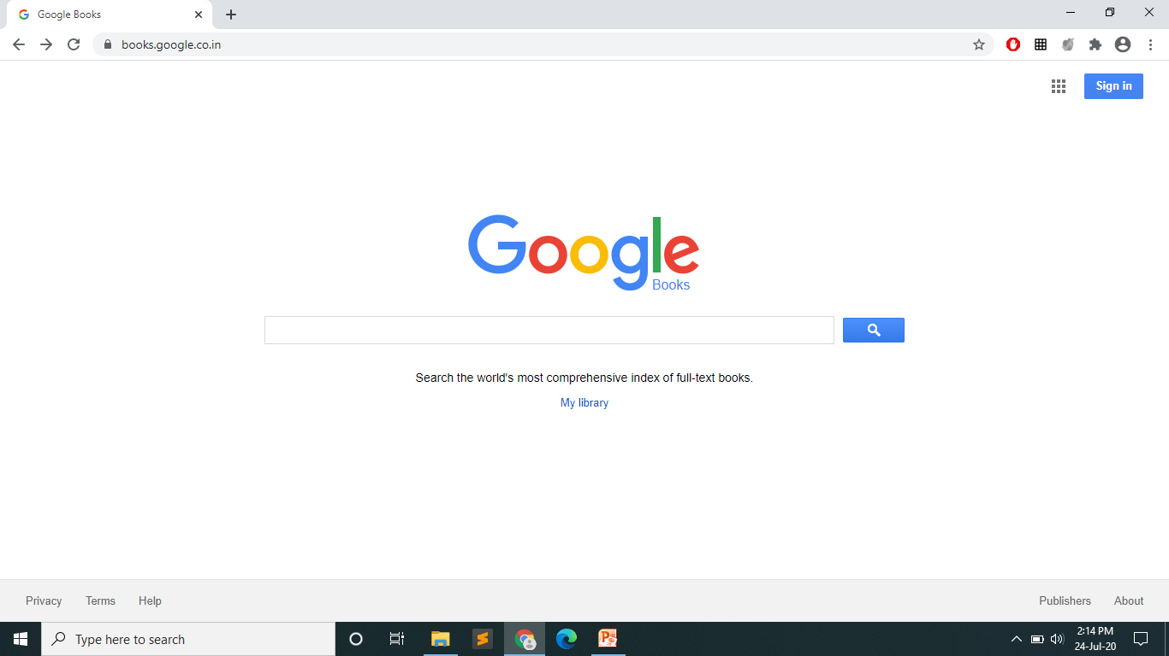
Cont..

Slide 81
7. Job Search :
Yahoo! Also has a number of vertical search engine products.
Yahoo! Hotjobs is an example of a product designed to allow people to search for jobs

Slide 82
Country Specific Search Engines :
At this stage, search is truly global in its reach
Google is the dominant search engine in many countries, but not all of them
According to comScore data from june 2011, Google receives 68.9% of all searches performed world wide
In addition, Google is the market share leader in every major market
China : Baidu has more than 75% market share in china
Russia : Yandex covers 65% share market in Russia
South Korea : Naver covers 70% share market there
Czech Republic : Seznam covers 45% market share there

Slide 83
Optimizing for specific countries :
One of the problems international businesses continuously need to address with search engines is identifying themselves as “local”
In other words, if a search engine user is located in France and wants to see where the grocery shop are in New Jersey, how does the SE know which results to show?
Owning the proper domain extension for the country that your business is targeting
Hosting your website in the country you are targeting (with country specific IP address)

Slide 84
Cont…
Registering with local search engines :
Google : http://www.google.com/local/add/
Yahoo! : http://listings.local.yahoo.com/csubmit/index.php
Bing : https://ssl.bing.com/listings/BusinessSearch.asp
Using native languages on the site
Placing relevant local address
Define your preferred region in Google Webmaster tools

